Slide 1
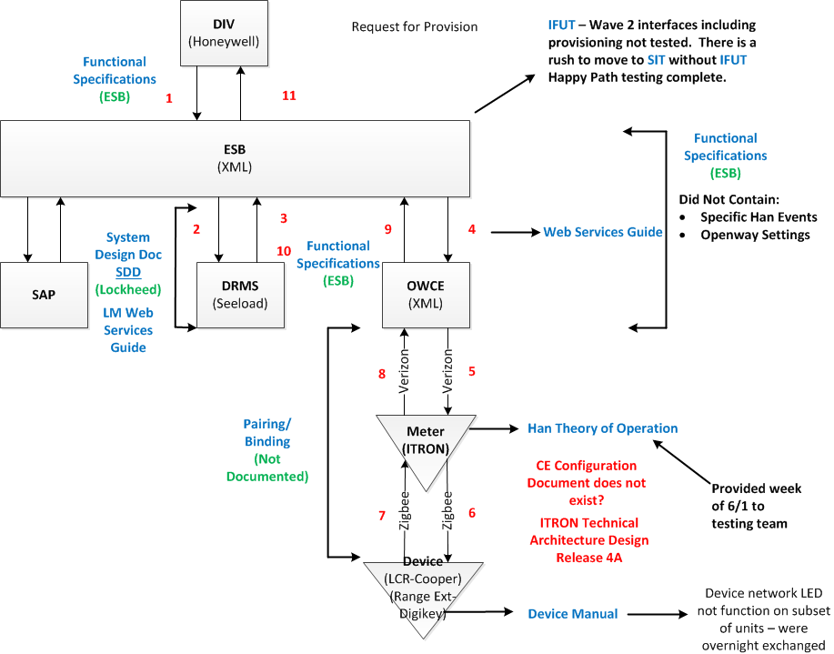
DRMS – Request for Provision Overview
PAO – 2015 06 09 v2

Slide 2
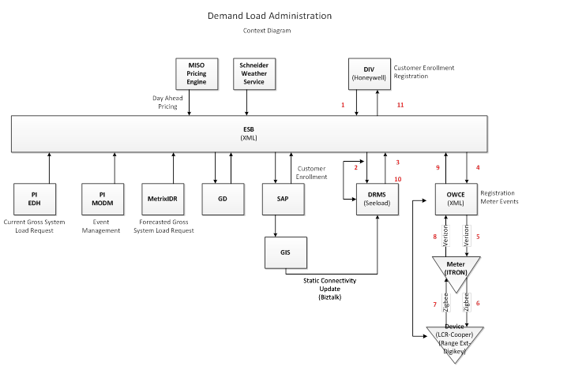
DRMS – Request for Provision Overview
PAO – 2015 06 09 v2

